Slide 1

Application Workshop: Washoe Opioid Abatement and Recovery Fund
Notes:
Introduction of me

Slide 2

Overview
Washoe Opioid Abatement and Recovery Fund (WOARF)
Grant Program Overview
Eligibility and Eligible Uses
Funding Priorities
Reporting Requirements
eCivis/Euna Grants
Application Portal
Budget Development
Timeline
Q&A

Slide 3

Washoe Opioid Abatement and Recovery Fund (WOARF)
Community Reinvestment Grant Program
$41 million to Washoe County over twenty years to:
Address the negative impacts of the opioid epidemic
Prevent additional morbidity and mortality
Build a strong, resilient, and equitable recovery.
So far Washoe County has received $11,430,000
$5,500,000 has been allocated

Slide 4
$3.5 million available
for eligible organizations providing service to Washoe County community members.
Up to 2-years funding allocations (7/1/2026 – 6/30/2028)
Successful projects funded under this cycle may be eligible for an abbreviated renewal period provided projects are still consistent with updated priorities in the most current Funding Plan and are meeting performance and reporting requirements.
Priority is given to projects that have strong sustainability plans to continue services

Slide 5

Grant Program Overview

Slide 6
Applicant Eligibility
Provide services in Washoe County
State of Nevada Certificate of Existence with Status of Good Standing
Nonprofit certificate 501(c)(3) or 501(c)(19)
Provide direct services to the Washoe County community
Unique Entity Identifier (UEI) active SAM.gov registration
Budget administrative expenses at or below five percent (5%)
No provider or Board Member excluded from participation in federal health care programs
Comply with the Third-Party Liability for any or all the expenditure(s) that would be payable by another private or public insurance
Once final proposals are chosen, your organization must provide certificate of insurance and a list of your current board of directors.
In accordance with NRS 244.1505, the Board of County Commissioners may grant all or part of the money to a nonprofit organization created for religious, charitable or educational purposes to be expended for the selected purpose.

Slide 7

Ineligible Activities
Purchase of any items that may be considered paraphernalia pursuant to NRS 453.
Activities that are not evidence-based or promising practices for opioid abatement.
Activities that are funded through other program grants or activities.
Activities not identified as a priority.
Admin activities over 5% of total budget.

Slide 8




Funding Priorities
Behavioral Health Supports for Peers and PWLE Staff
Street Health
Overdose Prevention
Housing Supports

Slide 9
Timeline
Washoe Opioid Abatement and Recovery Fund
March 1– April 15, 2026
Proposals Accepted
April 2026
Evaluate/Score
June 23, 2026
Board Approval
Q & A Period
March 1– March 22, 2026
March 15, 2026
Intent to Apply Due
May 2026
Award & Agreement
Development
July 1, 2026 – June 30, 2028
Performance Period

Slide 10
Application Attachments
Complete Application
Budget worksheet
Signed Conflict of Interest Form
Notes:
All docs are on the website
As is a PDF of the application questions for you to review so you can develop answers outside of the portal as need be

Slide 11
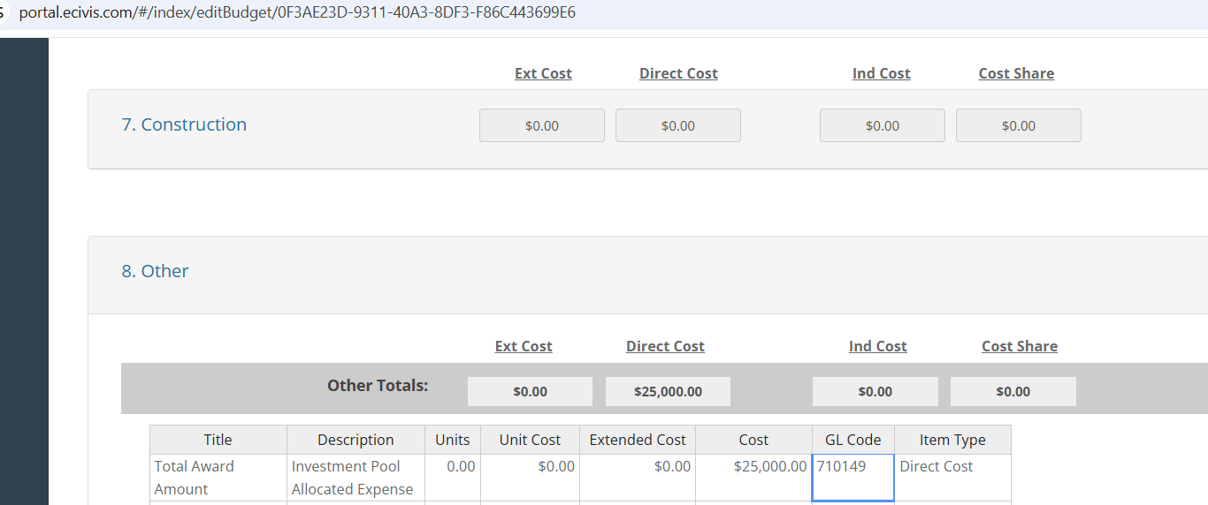
eCivis/Euna Grants Budget Template
Use the detailed narrative spreadsheet to complete your entire budget.
Simply put the total award request in the “Other” line item of the eCivis budget.

Slide 12
Evaluation and Selection Criteria
Evidence-based or evidence-informed, sustainable staffing and funding models
Alignment with 2026-2029 Needs Assessment and WOARF Funding Plan Priorities
Eligible Use under the One Nevada Agreement and Litigation Settlement Agreements
External and Internal Reviewers will review and score proposals using rubric developed by WOARF team
3-4 Reviewers
People with Lived Experience on every panel
Selections to be approved by the Board of County Commissioners

Slide 13
Project Scoring Matrix
Application | Scoring | Description and/or Application Section
Project Application Complete | P/F | Technical Review
Conflict of Interest | P/F | Technical Review Section U
Budget Narrative Complete | P/F | Technical Review (Separate Excel Document)
Key Personnel | 5 | Section E and Q
Sustainability | 5 | Section R and Budget Narrative Implementation Potential
Abstract | 5 | Section K
Washoe County Applicant | 5 | Section A and B
Organizational Capacity | 15 | Section L
Project Design & Implementation | 25 | Section M (Program details)
Capabilities & Competencies | 20 | Section N (specific to proposed scope)
Data Collection | 10 | Section O (ability of agency to collect data)
Scope of Work | 10 | Section P
All assurances signed | P/F | Technical Review
Risk Management | P/F | Technical Review
Total | 100

Slide 14
Reporting and Management
Quarterly Financial and Activity Reporting will be required for all awardees due 15 days after the close of the quarter
Activity Report – Brief status update on project progress and data on the performance measures.
Financial Report - Detailed financial reports are required to submit for draw requests for reimbursement of allocable activities.

Slide 15

eCivis
Grant solicitation: https://gn.ecivis.com/GO/gn_redir/T/c1u5zuo7unks
Grant Website: https://www.washoecounty.gov/mgrsoff/divisions/Community%20Reinvestment/WOARF/index.php
For questions and technical assistance navigating eCivis, please contact Lauren Beal at woarf@washoecounty.gov or 775-516-5635

Slide 16
Questions?

Slide 17
Thank you!
For questions, contact:
Lauren Beal
woarf@washoecounty.gov
775-516-5635

